Slide 1


Janani RC
1/8/2024

Slide 2

Outline
Executive Summary
Introduction
Methodology
Results
Conclusion
Appendix

Slide 3
Executive Summary
Summary of methodologies
Data Collection
Data Wrangling
Exploratory Data Analysis with SQL
Exploratory Data Analysis with Data Visualization
Interactive map with Folium
Dashboard with Ploty Dash
Machine learning(Predictive analysis)
Summary of all results
Exploratory Data Analysis results
Interactive analytics demo in screenshot
Predictive analysis results

Slide 4
Introduction
Project background and context
SpaceX has revolutionized the commercial space industry by making space travel more affordable. The company offers Falcon 9 rocket launches for $62 million on its website, significantly lower than the over $165 million charged by other providers. This cost reduction is largely due to SpaceX's ability to reuse the first stage of their rockets. By predicting whether the first stage will successfully land, we can estimate the cost of a launch. Utilizing publicly available data and machine learning models, our goal is to forecast the likelihood of SpaceX reusing the first stage.
Problems you want to find answers
How do factors like payload mass, launch site, number of flights, and orbits influence the success of the first stage landing?
Has the success rate of first stage landings improved over the years ?
What is the most effective algorithm for binary classification in this context?

Slide 5

Section 1

Slide 6
Methodology
Executive Summary
Data collection methodology:
Using Space Rest API and Web scrapping
Perform data wrangling
Filtering the data
Finding missing values from table
Using One Hot Encoding to prepare the data to a binary classification
Perform exploratory data analysis (EDA) using visualization and SQL
Perform interactive visual analytics using Folium and Plotly Dash
Perform predictive analysis using classification models
Build,tuning and evaluating of classification models to ensure the best results had been obtained.

Slide 7
Data Collection
The data collection process involved a combination of API requests from the SpaceX REST API and web scraping from a table on SpaceX's Wikipedia page to gather comprehensive information about the launches for detailed analysis. Data columns obtained from the SpaceX REST API include: FlightNumber, Date, BoosterVersion, PayloadMass, Orbit, LaunchSite, Outcome, Flights, GridFins, Reused, Legs, LandingPad, Block, ReusedCount, Serial, Longitude, and Latitude. Data columns obtained from Wikipedia web scraping include: Flight No., Launch site, Payload, PayloadMass, Orbit, Customer, Launch outcome, Version Booster, Booster landing, Date, and Time.

Slide 8
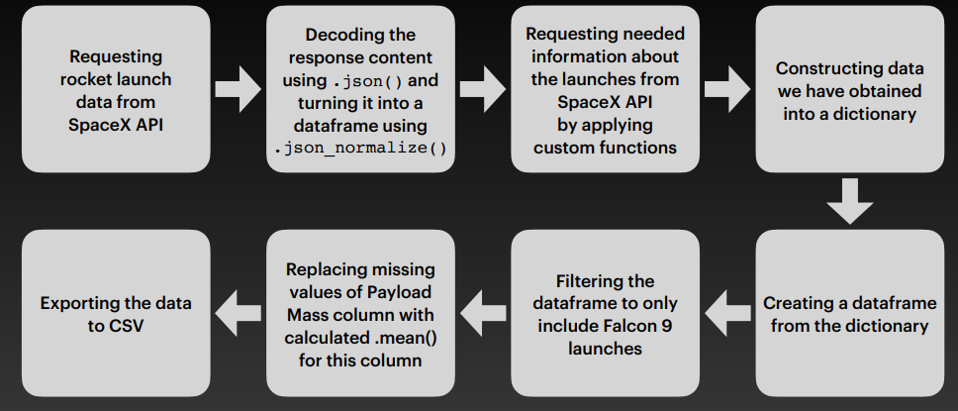
Data Collection – SpaceX API
https://github.com/Janani-Ironic69/Applied-Data-Science-Capstone-Project/blob/main/jupyter-labs-spacex-data-collection-api.ipynb
Place your flowchart of SpaceX API calls here

Slide 9
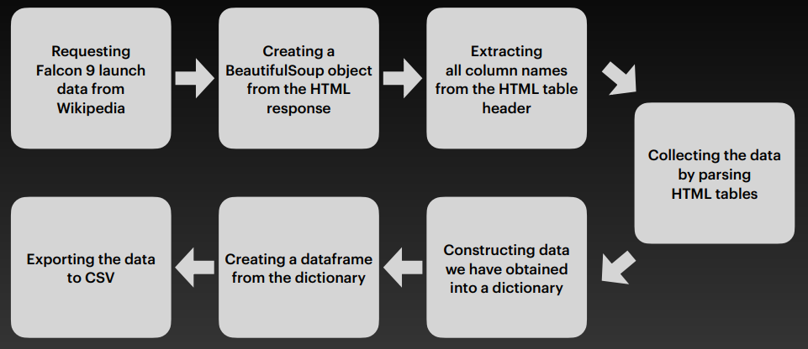
Data Collection - Scraping
Place your flowchart of web scraping here
https://github.com/Janani-Ironic69/Applied-Data-Science-Capstone-Project/blob/main/jupyter-labs-webscraping.ipynb

Slide 10
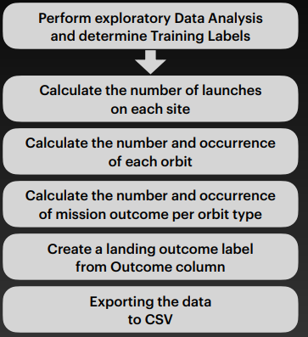
Data Wrangling
In the dataset, there are various instances where the booster did not land successfully. Sometimes, a landing was attempted but failed due to an accident. For instance, "True Ocean" indicates the mission outcome was a successful landing in a specific region of the ocean, while "False Ocean" signifies the mission outcome was an unsuccessful landing in the same region. Similarly, "True RTLS" denotes the mission outcome was a successful landing on a ground pad, whereas "False RTLS" indicates an unsuccessful landing on a ground pad. "True ASDS" means the mission outcome was a successful landing on a drone ship, and "False ASDS" means the mission outcome was an unsuccessful landing on a drone ship. We primarily convert these outcomes into training labels, where "1" represents a successful booster landing, and "0" indicates an unsuccessful attempt.
https://github.com/Janani-Ironic69/Applied-Data-Science-Capstone-Project/blob/main/labs-jupyter-spacex-Data%20wrangling.ipynb

Slide 11
EDA with Data Visualization
Charts were created as follows: Flight Number vs. Payload Mass, Flight Number vs. Launch Site, Payload Mass vs. Launch Site, Orbit Type vs. Success Rate, Flight Number vs. Orbit Type, Payload Mass vs. Orbit Type, and Success Rate Yearly Trend.
Scatter plots were used to display the relationships between variables. If there is a relationship, these plots could be useful for machine learning models.
Bar charts were used to compare different discrete categories, aiming to illustrate the relationship between the categories being compared and a measured value.
Line charts were used to depict trends in data over time (time series).
https://github.com/Janani-Ironic69/Applied-Data-Science-Capstone-Project/blob/main/edadataviz.ipynb

Slide 12
EDA with SQL
SQL queries were executed to:
Display the names of the distinct launch sites used in the space missions.
Show 5 records where the launch sites start with the string 'CCA'.
Show the total payload mass carried by boosters launched by NASA (CRS).
Show the average payload mass carried by booster version F9 v1.1.
List the date when the first successful landing on a ground pad was achieved.
List the names of boosters that have successfully landed on a drone ship and carried a payload mass greater than 4000 but less than 6000.
Show the total number of successful and failed mission outcomes.
List the names of the booster versions that have carried the maximum payload mass.
Show the failed landing outcomes on drone ships, their booster versions, and launch site names for the months in the year 2015.
Rank the count of landing outcomes (e.g., Failure (drone ship) or Success (ground pad)) between the dates 2010-06-04 and 2017-03-20 in descending order.
https://github.com/Janani-Ironic69/Applied-Data-Science-Capstone-Project/blob/main/jupyter-labs-eda-sql-coursera_sqllite.ipynb

Slide 13
Build an Interactive Map with Folium
Markers for all Launch Sites:
A marker was added with a circle, popup label, and text label for NASA Johnson Space Center, using its latitude and longitude coordinates as the starting location.
Markers with circles, popup labels, and text labels were added for all launch sites, using their latitude and longitude coordinates to display their geographical locations and proximity to the equator and coasts.
Colored Markers for Launch Outcomes at Each Launch Site:
Colored markers were added to indicate successful (green) and failed (red) launches, using marker clusters to identify which launch sites have higher success rates.
Distances Between a Launch Site and Its Proximities:
Colored lines were added to show the distances between the launch site KSC LC-39A (as an example) and its proximities, such as railway, highway, coastline, and the closest city.
https://github.com/Janani-Ironic69/Applied-Data-Science-Capstone-Project/blob/main/lab_jupyter_launch_site_location.ipynb

Slide 14
Build a Dashboard with Plotly Dash
Launch Sites Dropdown List:
Included a dropdown list to allow the selection of Launch Sites.
Pie Chart Displaying Successful Launches (All Sites/Specific Site):
Added a pie chart to visualize the total number of successful launches across all sites and the Success vs. Failure counts for a selected site, if applicable.
Payload Mass Range Slider:
Implemented a slider to choose the range of Payload Mass.
Scatter Chart of Payload Mass vs. Success Rate for Different Booster Versions:
Added a scatter chart to illustrate the relationship between Payload Mass and Launch Success Rate.
https://github.com/Janani-Ironic69/Applied-Data-Science-Capstone-Project/blob/main/spacex_dash_app.py

Slide 15
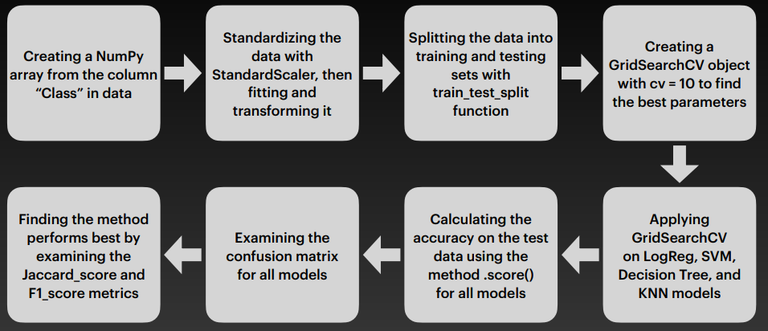
Predictive Analysis (Classification)
1. Data Preparation: Extract the "Class" column as a NumPy array, then standardize the data using StandardScaler.
2. Data Splitting: Divide the dataset into training and testing sets using train_test_split.
3. Hyperparameter Tuning: Use GridSearchCV with 10-fold cross-validation to optimize parameters for models including Logistic Regression, SVM, Decision Tree, and KNN.
4. Model Evaluation: Assess model performance on the test set using accuracy, confusion matrices, and metrics like Jaccard score and F1 score to identify the best-performing model.
https://github.com/Janani-Ironic69/Applied-Data-Science-Capstone-Project/blob/main/SpaceX_Machine%20Learning%20Prediction_Part_5%5B1%5D.ipynb

Slide 16
Results
Exploratory data analysis results
Interactive analytics demo in screenshots
Predictive analysis results

Slide 17

Section 2

Slide 18
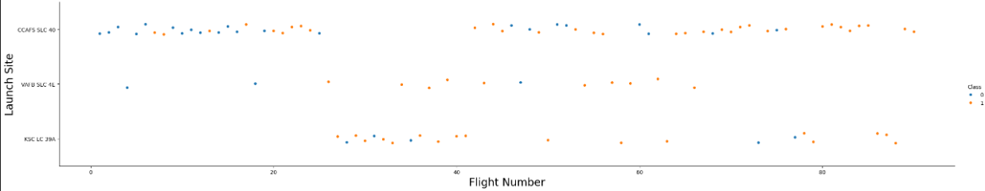
Flight Number vs. Launch Site
Explaination:
Initially, flights were unsuccessful, but recent launches have consistently been successful.
The CCAFS SLC 40 launch site accounts for approximately half of all launches.
Both VAFB SLC 4E and KSC LC 39A exhibit higher success rates.
It's likely that the probability of success increases with each new launch.

Slide 19
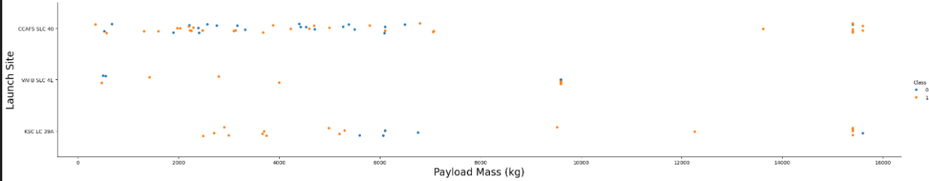
Payload vs. Launch Site
Explaination:
A greater payload mass at any launch site correlates with an increased success rate.
Launches carrying payloads exceeding 7000 kg generally achieved success.
The KSC LC 39A site boasts a perfect success rate for payloads weighing under 5500 kg as well.

Slide 20
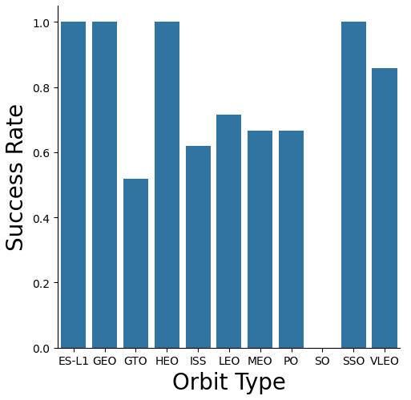
Success Rate vs. Orbit Type
Explaination:
Orbits with complete success rates include ES-L1, GEO, HEO, and SSO.
The SO orbit has a 0% success rate.
Orbits with success rates ranging from 50% to 85% are GTO, ISS, LEO, MEO, and PO.

Slide 21
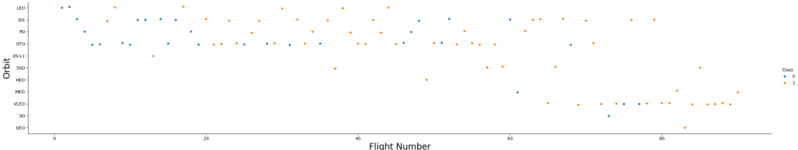
Flight Number vs. Orbit Type
Explaination:
In the LEO orbit, success seems to be linked to the number of flights.
Conversely, in the GTO orbit, there appears to be no correlation between the number of flights and success.

Slide 22
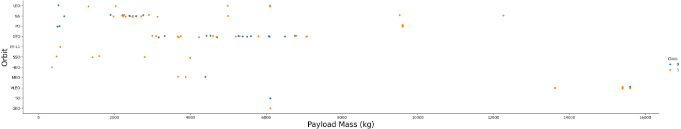
Payload vs. Orbit Type
Explanation:
• Heavy payloads have a negative influence on GTO orbits and positive on GTO and Polar LEO (ISS) orbits.

Slide 23
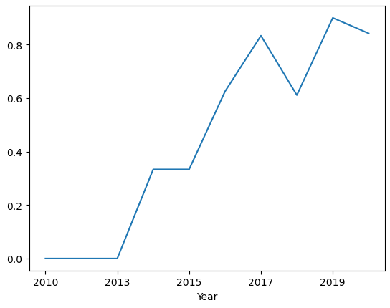
Launch Success Yearly Trend
The success rate start increasing from 2013 and kept increasing ever since.

Slide 24
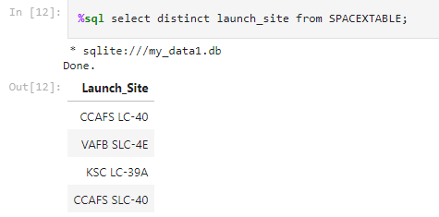
All Launch Site Names
Represented all the unique launch site name from the spacex table

Slide 25
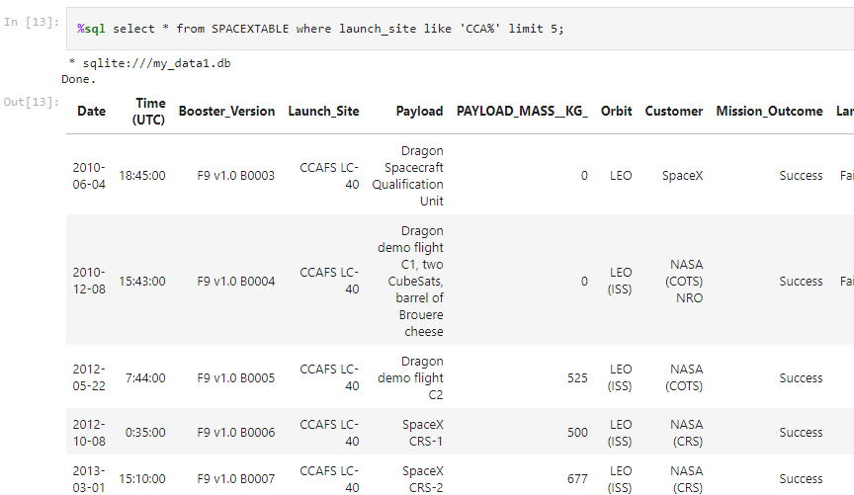
Launch Site Names Begin with 'CCA'
Displayed 5 records where launch site began with the string like ‘CCA’

Slide 26
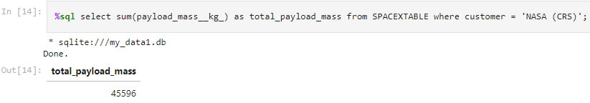
Total Payload Mass
Displayed total payload mass where boosters were launched by NASA

Slide 27
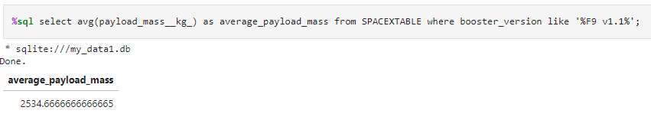
Average Payload Mass by F9 v1.1
Displayed the average payload mass carried by the booster whose version is F9 v1.1

Slide 28
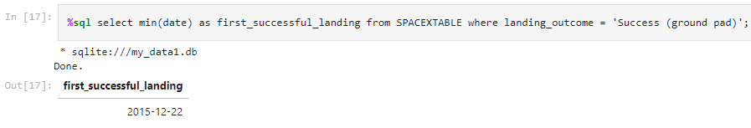
First Successful Ground Landing Date
Displayed the first successful landing date from the table whose outcome is success and retrieved the lowest date using min function.

Slide 29
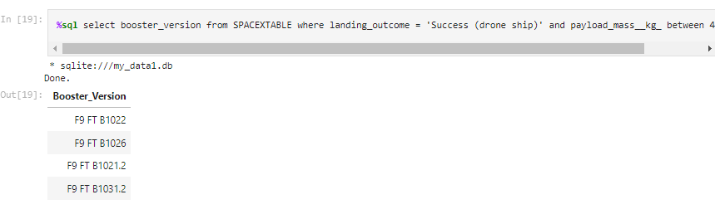
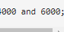
Successful Drone Ship Landing with Payload between 4000 and 6000
Listed all the booster version which have successful landed in drone ship with payload in between 4000 and 6000

Slide 30
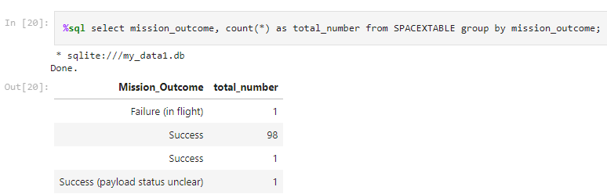
Total Number of Successful and Failure Mission Outcomes
Displayed the total number of successful and failure mission

Slide 31
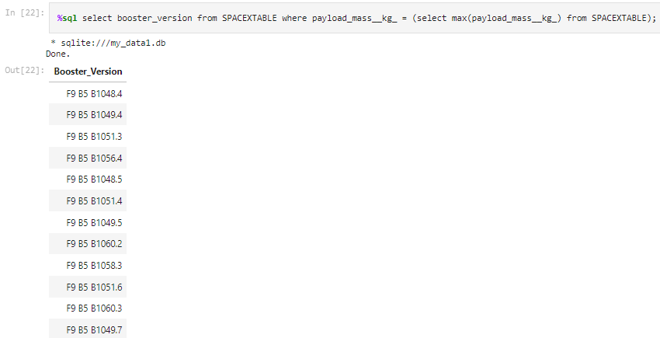
Boosters Carried Maximum Payload
Displayed the booster version which carried the maximum load using a sub query which retrieved the max payload first.

Slide 32
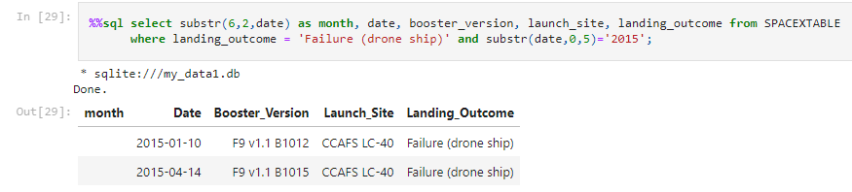
2015 Launch Records
Listed all failed landing outcomes in drone ship,their booster version along with launch site for the months in year 2015

Slide 33
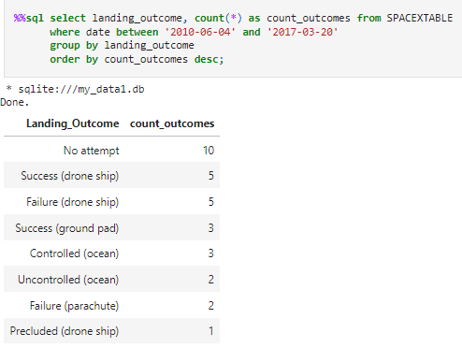
Rank Landing Outcomes Between 2010-06-04 and 2017-03-20
Ranking the count of landing outcomes (such as Failure (drone ship) or Success (ground pad)) between the date 2010-06-04 and 2017-03-20 in descending order.

Slide 34

Section 3

Slide 35
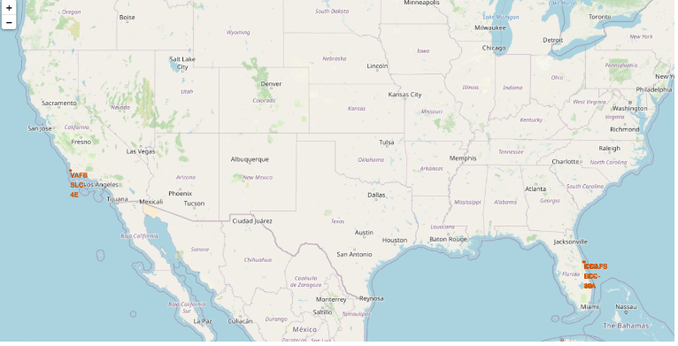
Location of all launch sites on a world map
Explaination:-
The majority of launch sites are located near the Equator. At the Equator, the Earth's surface moves faster than at any other latitude, with a speed of 1670 km/hour. This rotational velocity provides an initial boost due to inertia when a spacecraft is launched, helping it maintain the necessary speed to stay in orbit.
All launch sites are situated close to coastal areas. Launching rockets towards the ocean minimizes the risk of debris or explosions impacting populated areas, enhancing safety.

Slide 36
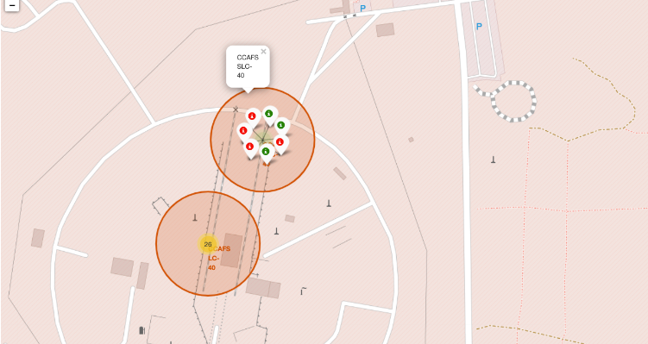
Color labelling success and failure records on the map
Explaination:
Color-coded markers are used to indicate the success rates of launch sites.
Green Marker: Represents a successful launch.
Red Marker: Represents a failed launch.

Slide 37
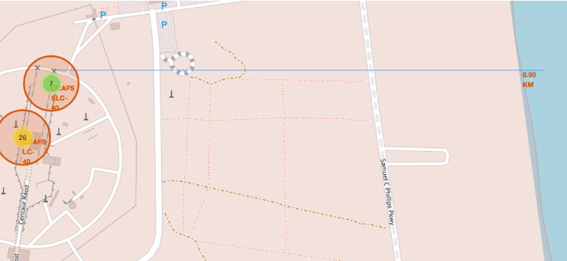
Geographical layout and proximity analysis of CCAFS SLC-40 and LC-40 Launch sites
The image shows a map highlighting the positions and proximities of two launch sites labeled CCAFS SLC-40 and LC-40. The following details are noted:
Green Marker (7): Likely represents successful launches from the CCAFS SLC-40 site.
Yellow Marker (26): Possibly indicates the total number of launches, with the difference in color potentially denoting different outcomes or statuses (such as successful or failed launches).
The map also shows the locations relative to major nearby infrastructure:
Proximity to the Coast: The coastline is marked 0.90 km from the identified locations.
Nearby Roadways: Samuel C Phillips Pkwy is indicated nearby, suggesting accessibility and logistical considerations.
The circles around the launch sites may represent zones of interest or safety areas, although their specific meanings aren't explicitly detailed in the image alone. The map provides a visual representation of the geographical layout and distances, useful for understanding the logistics and safety implications related to the launch activities at these sites.

Slide 38

Section 4

Slide 39
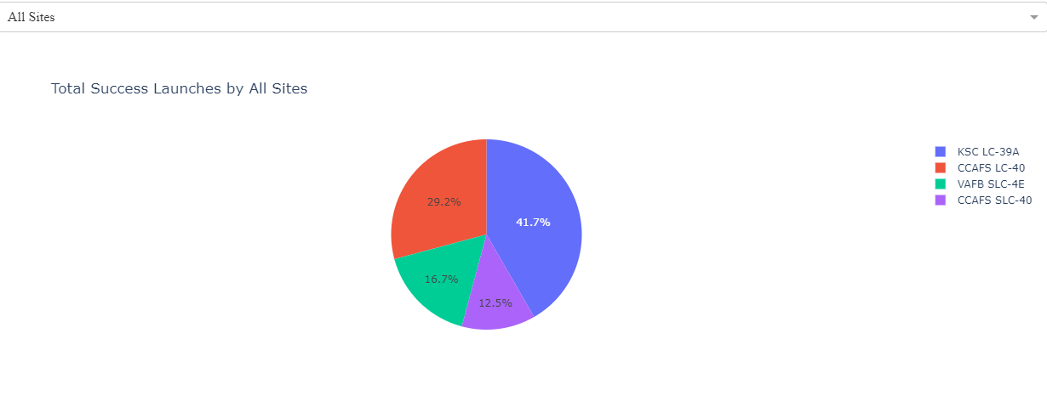
Total success launches by all sites
The pie chart shows the percentage distribution of total successful launches across four sites: KSC LC-39A (41.7%), CCAFS LC-40 (29.2%), VAFB SLC-4E (16.7%), and CCAFS SLC-40 (12.5%). The largest share of successful launches is attributed to KSC LC-39A.

Slide 40
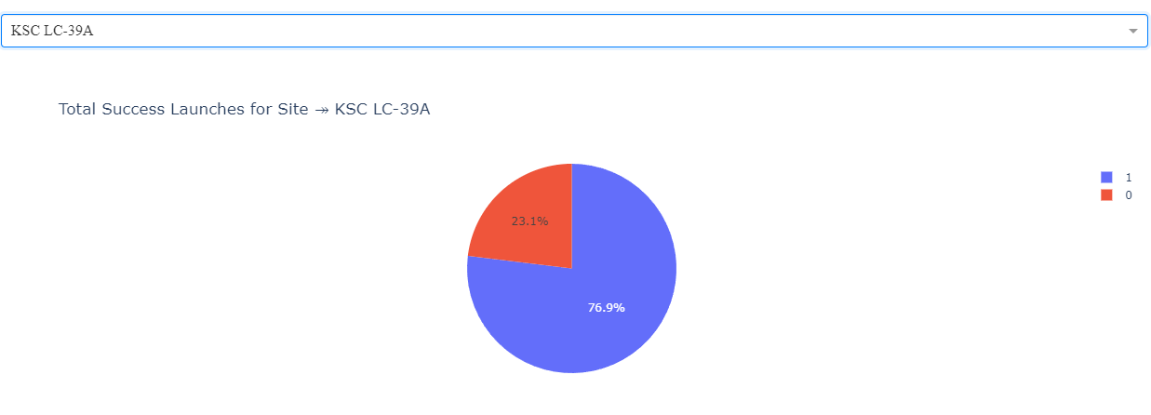
KSC LC-39A pie chart i.e having highest launch rate
KSC LC-39A has the highest launch success rate with 76.9 %

Slide 41
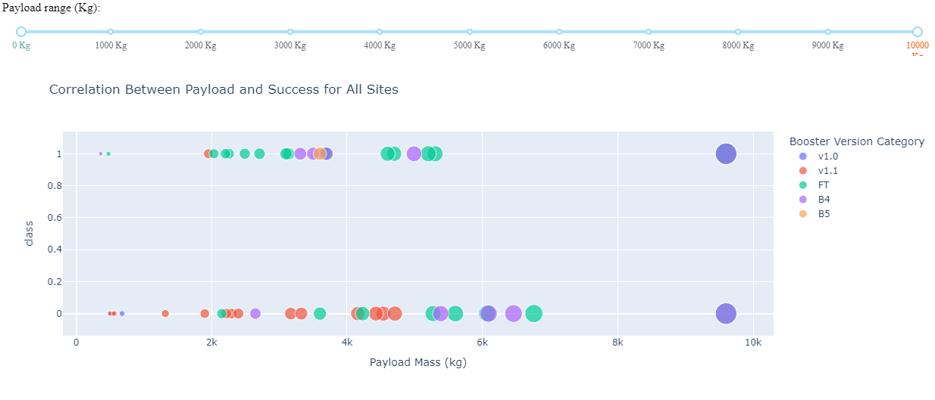
Payload VS Launch outcome
The chart shows the success rate compared to payload mass FT has high success rate with payload mass below 6000kg

Slide 42

Section 5

Slide 43
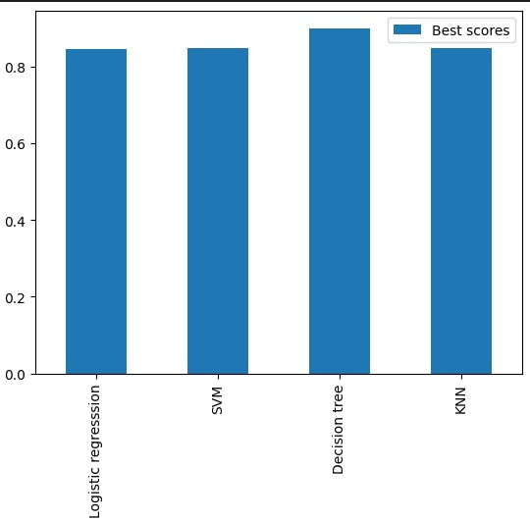
Classification Accuracy
Visualized all the models via bar graph and took the observation that Decision tree has the highest accuracy

Slide 44
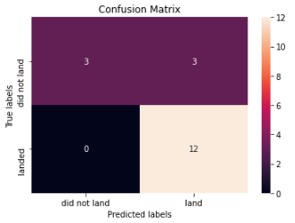
Confusion Matrix
The confusion matrix of decision tree shows the highest accuracy with only problem as false positives.

Slide 45
Conclusions
The Decision Tree Model has proven to be the most effective algorithm for this dataset.
Launches carrying lighter payloads tend to yield better outcomes compared to those with heavier payloads.
Most launch sites are located near the Equator and are all situated close to the coast.
The success rate of launches has shown an upward trend over the years.
KSC LC-39A boasts the highest success rate among all launch sites.
The orbits ES-L1, GEO, HEO, and SSO have achieved a 100% success rate.

Slide 46


